Slide 1



Scalable-ETL-development for The café using AWS cloud
Team 2 Group Project
a
De-Lon 6
Notes:
Names are listed alphabetically

Slide 2
Contents
a
Meet the Team
Problem statement
Planning
Technologies used
Architecture
Schema
Extract / Clean
Transform
Load
CI/CD architecture
CI/CD using codeBuild
Successful implementation
CI/CD GitHub Integration - AWS Lambda
Analysis & Trends (Grafana)
Monitoring Infrastructure
Insights / Maximum Viable Product (MVPs)
What? Where? When?
Wrap up

Slide 3
Problem Statement
a
Client: Pop-up café
Who want us to help them log and track orders
To track transactions across all outlets for new and returning customers
Identify the latest trends and make business decisions, to maximise revenue and profits
Current software has limitations and is time consuming to gather reports from all branches
Our Approach
Building a fully scalable ETL (Extract, Transform, Load) pipeline to handle large volumes of transaction data from multiple stores
Use Grafana for data visualization by querying on the transformed data, enabling the client to identify company-wide trends and insights

Slide 4






Technologies
s
Python:
Developing our application
RDBMS:
Postgresql
GitHub:
Source control
AWS Services:
ETL from S3 to Redshift Data warehouse
Grafana:
Application monitoring & Visualisation
Trello:
Agile project management principles - SCRUM sprints

Slide 5
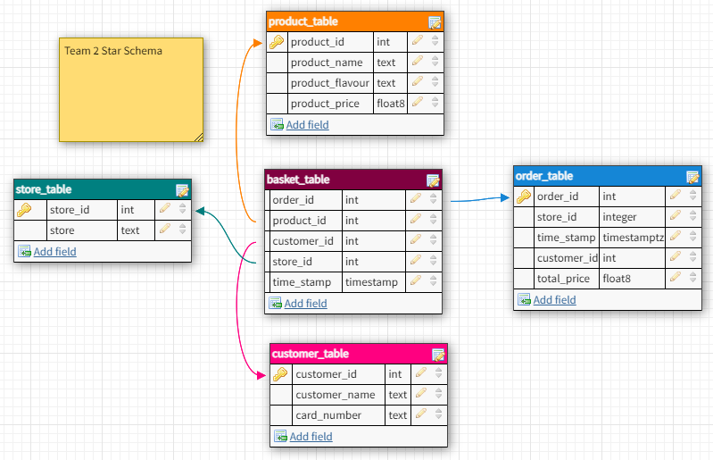
Star schema
s

Slide 6
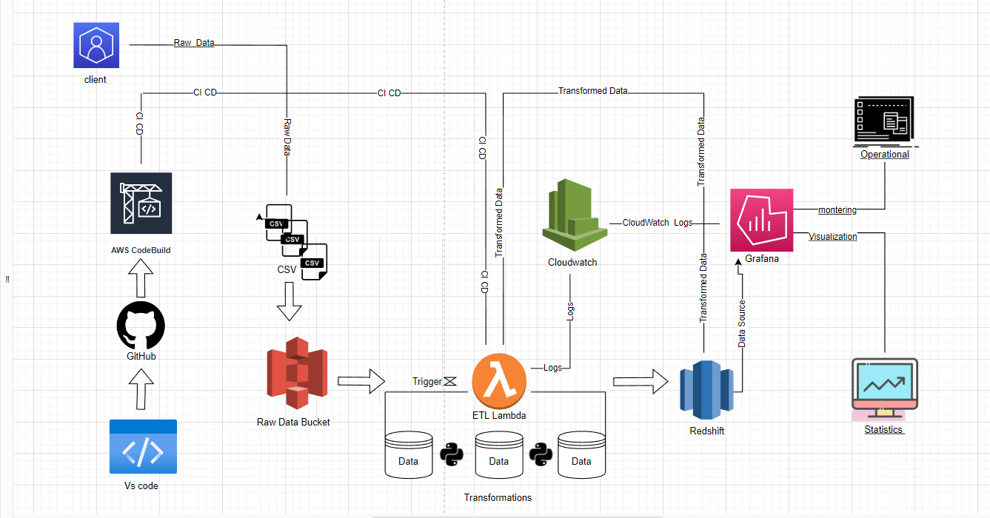
ETL Pipeline Architecture
a

Slide 7
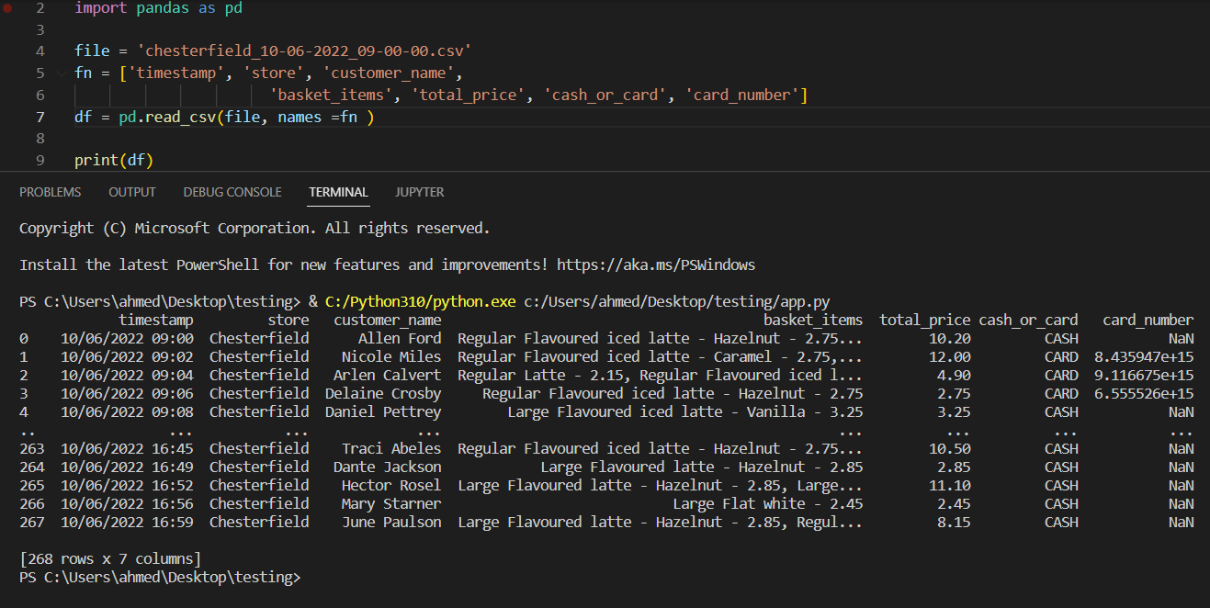



Extract / Clean
a
Raw data extracted from CSV file & read as dataframe (Data Ingestion)
EXTRACT

Slide 8



Transform
m
Dataframe transformed into enriched dataframe with desired schema and respective values
Notes:
Data is being transformed from data frame to star schema and populated with original data
Testing using docker with postgres in local network.
If we have more time we may even upload the docker image too. But we only have 5 weeks to make this MVP
When everyone is good we push to cloud.

Slide 9


Load
m
Loading transformed data tables into Redshift using database connection credentials
LOAD
Notes:
Loading transformed data from tables to redshift data warehouse
Redshift is fast and easy and secure analytic at scale
It Offers Significant Query Speed Upgrades.
It Focuses on Ease of Use and Accessibility.
It Provides Fast Scaling With Few Complications.
It Keeps Costs Relatively Low.
It Gives You Robust Security Tools.

Slide 10
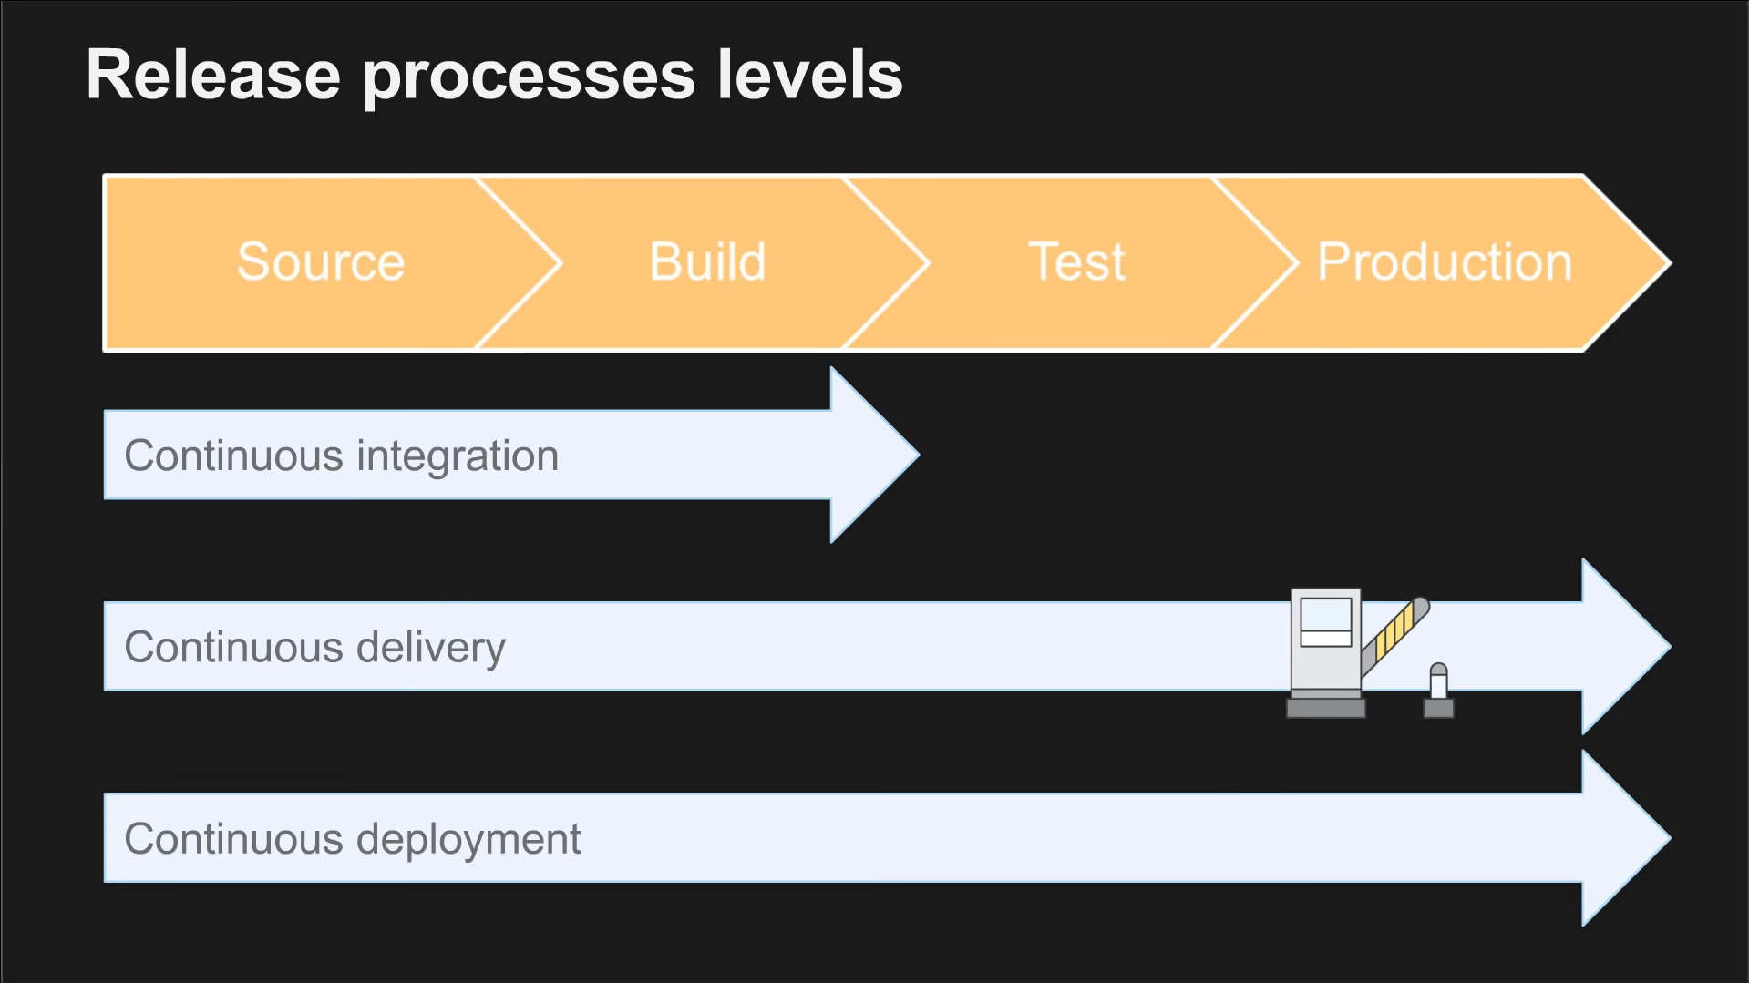
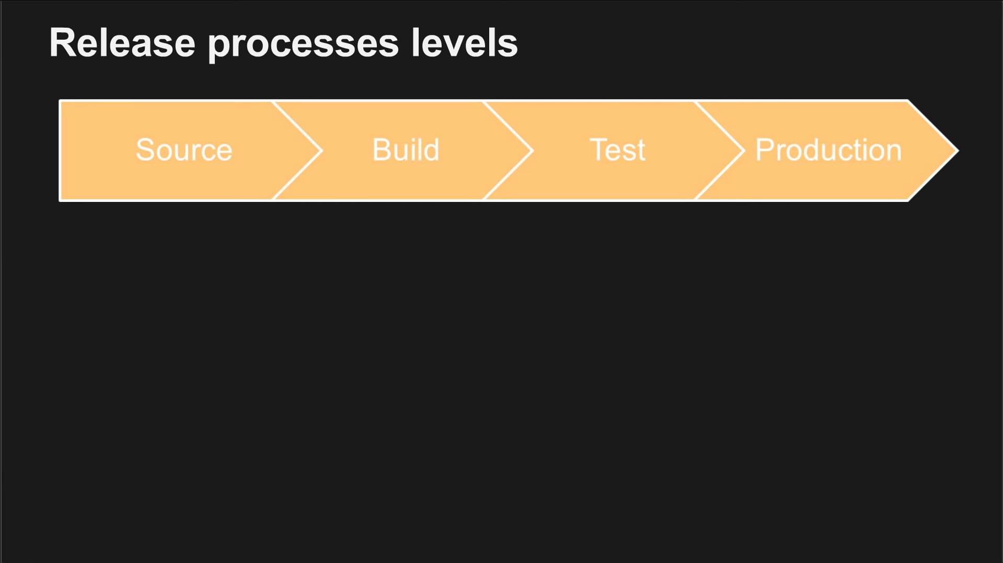
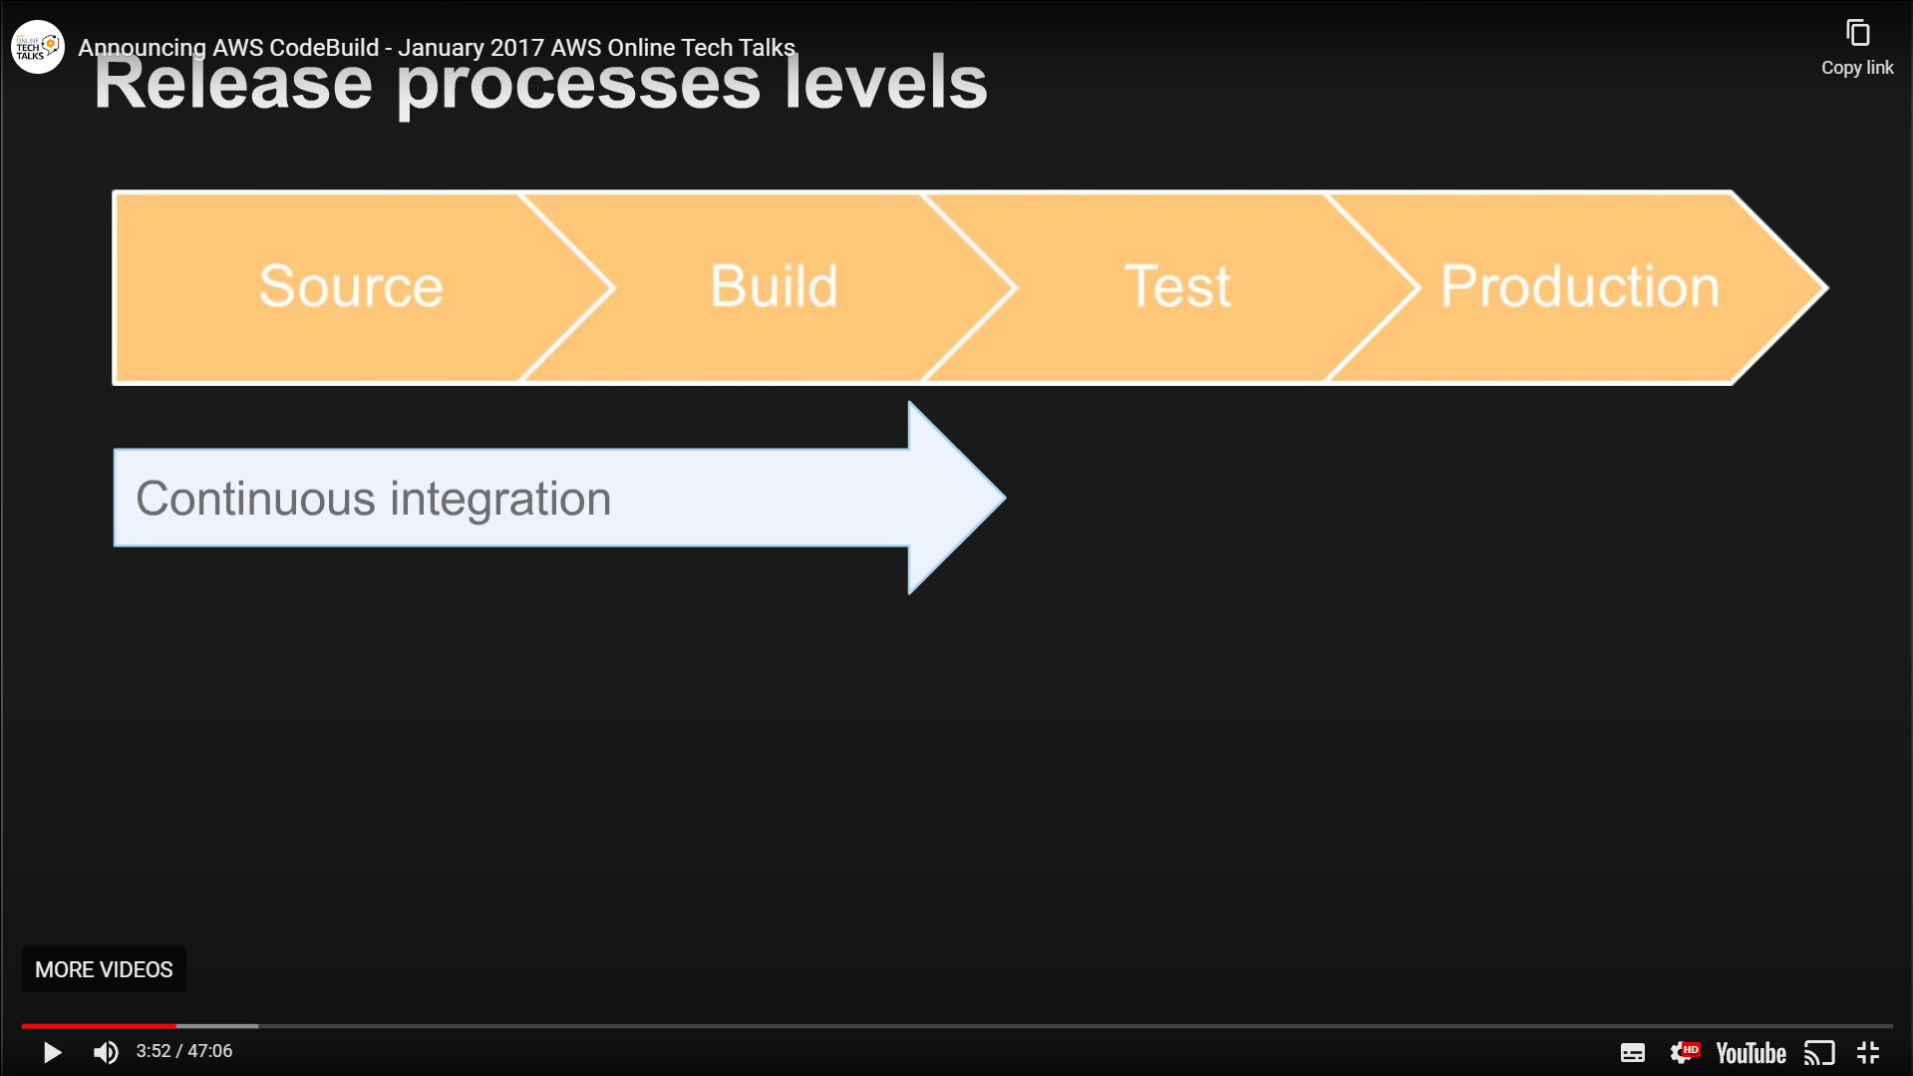
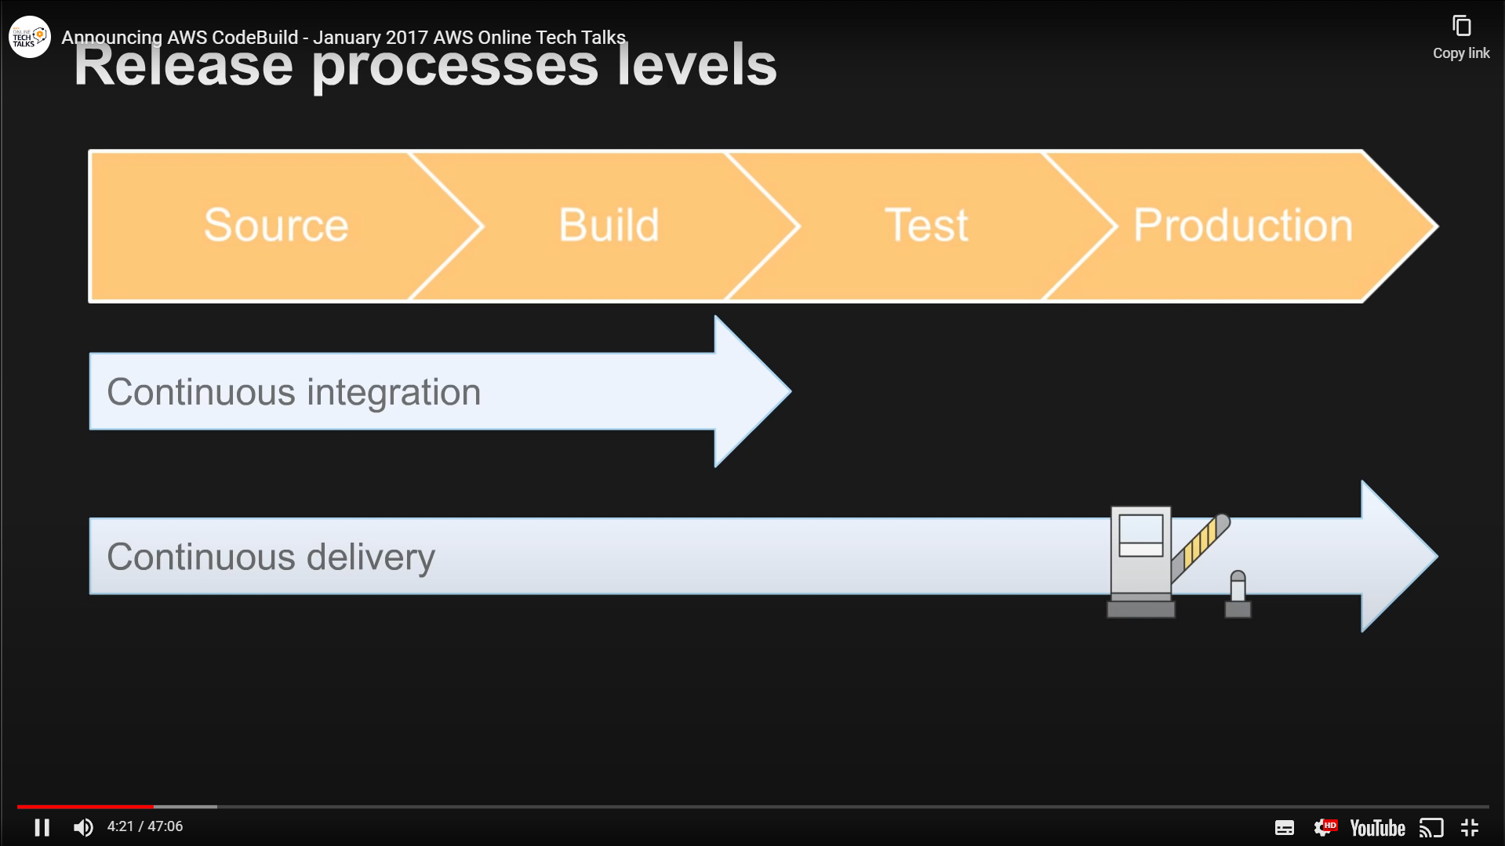
CI/CD Using CodeBuild
m
Why CI/CD?
To deliver a new version of software - series of steps required
CI/CD automate these steps to improve software delivery throughout the software development life cycle
Why CodeBUILD?
Fully managed continuous integration service
Readily deployable software packages
Continuous scaling and concurrent processing of multiple builds
Quick start by using prepackaged build environments
Charged by the minute for the compute
Notes:
We do the Continuous Integration using CodeBuild by AWS, this pull any changes that we made on our VScode that is git push to GitHub. Codebuild will automatically grab the new pushed code. Test it, if the code is working it will be uploaded by zipping it into deployment package and deploy the code into our lambda
We set up the Continuous Deployment using the Lambda function provided by AWS. Our Lambda will continuously deploy using the code provided in the zip, and whenever there’s a trigger, ie a new file landing in the s3 bucket, then the code will activate and transform the csv file into Redshift
Can be easily integrated into CodePipeline by AWS
Fully managed build service that compiles source code, runs tests, and produces software packages Scales continuously and processes multiple builds concurrently
You can provide custom build environments suited to your needs via Docker images.
Only pay by the minute for the compute resources you use (github $0.008, CodeBuild$0.005) However, GitHub would be cheaper if you uses freetier
Compiles source code, Runs tests

Slide 11
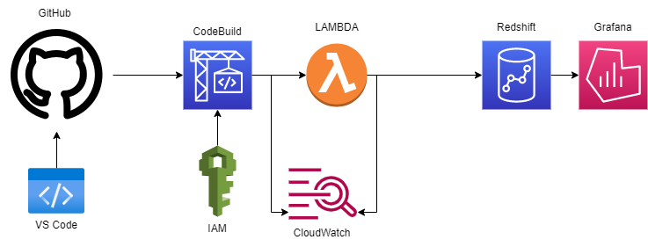

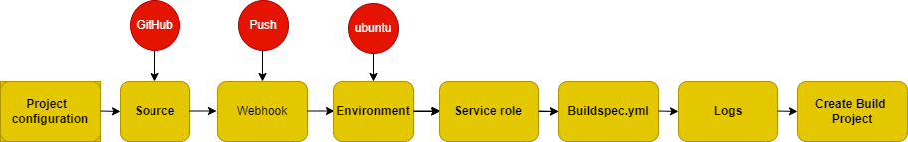
CI/CD Architecture
b
Notes:
We do the Continuous Integration using CodeBuild by AWS, this pull any changes that we made on our VScode that is git push to GitHub. Codebuild will automatically grab the new pushed code. and upload and zip it and deploy the code into our lambda
We set up the Continuous Deployment using the Lambda function provided by AWS. Our Lambda will continuously deploy using the code provided in the zip, and whenever there’s a trigger, ie a new file landing in the s3 bucket, then the code will activate and transform the csv file into Redshift

Slide 12
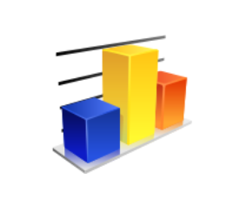
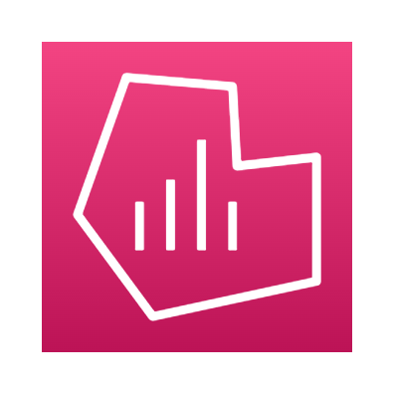
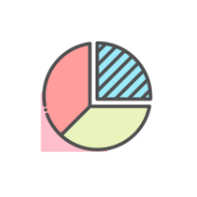


Analysis & Trends
g
Grafana configured with Redshift for database access & Cloudwatch for Lambda, EC2 monitoring

Slide 13
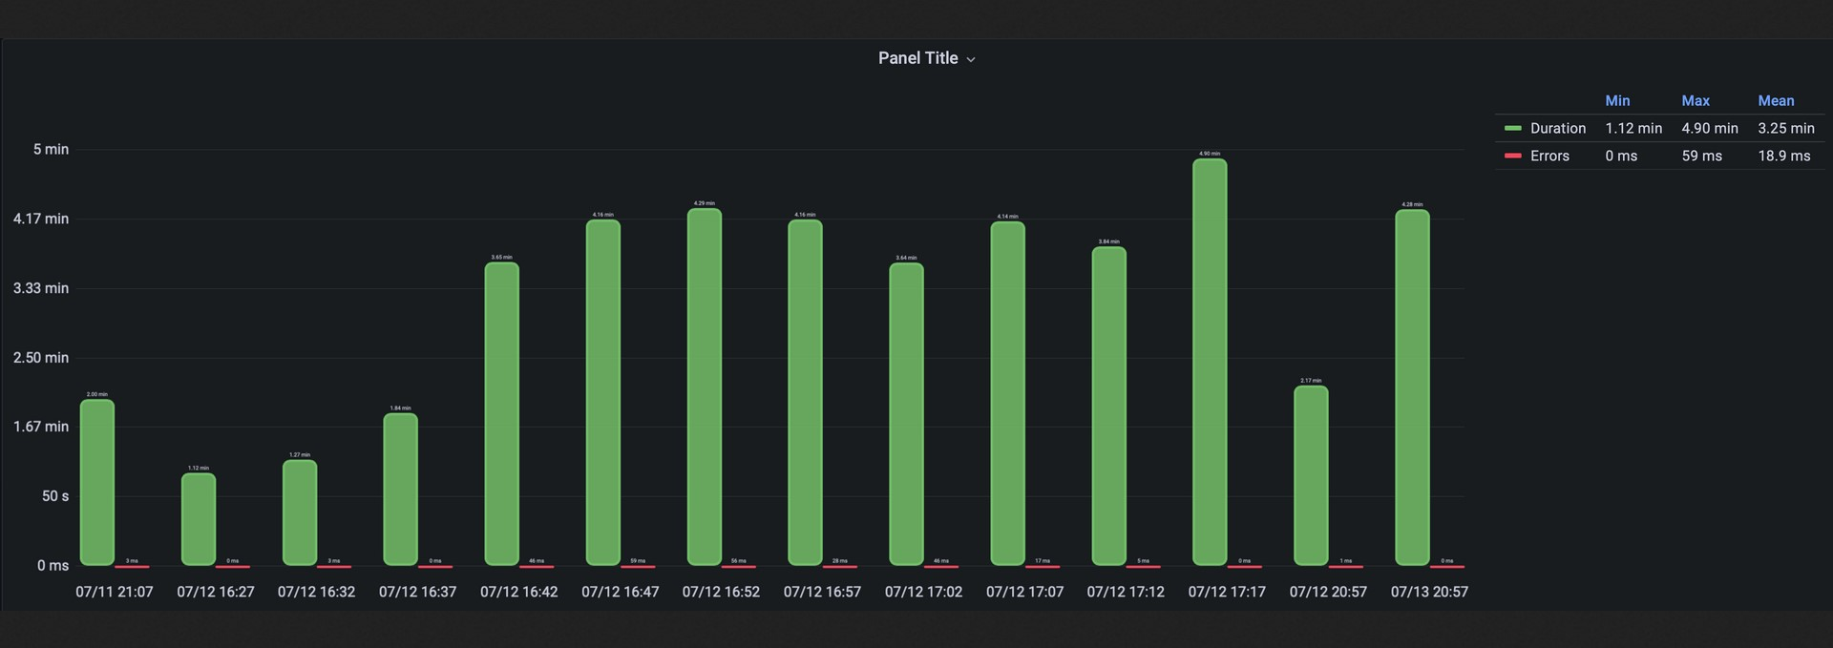
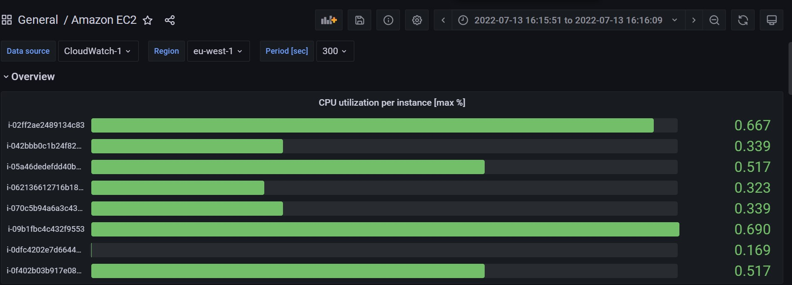
g
Monitoring Infrastructure
Lambda
Durations
EC2 Metrics

Slide 14
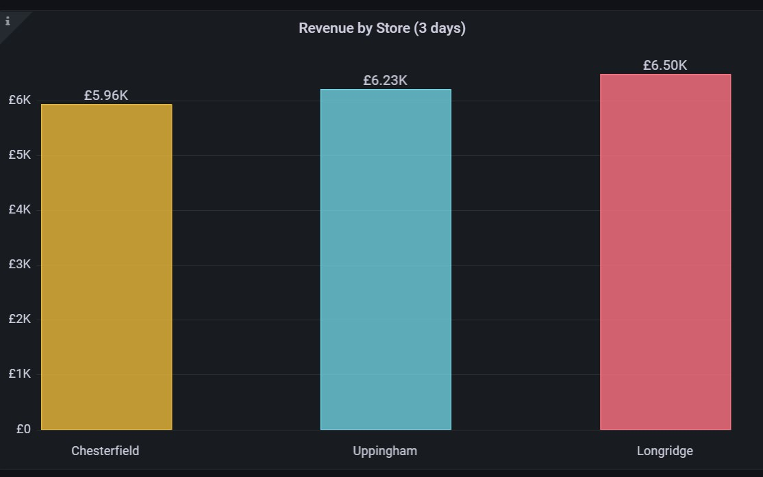
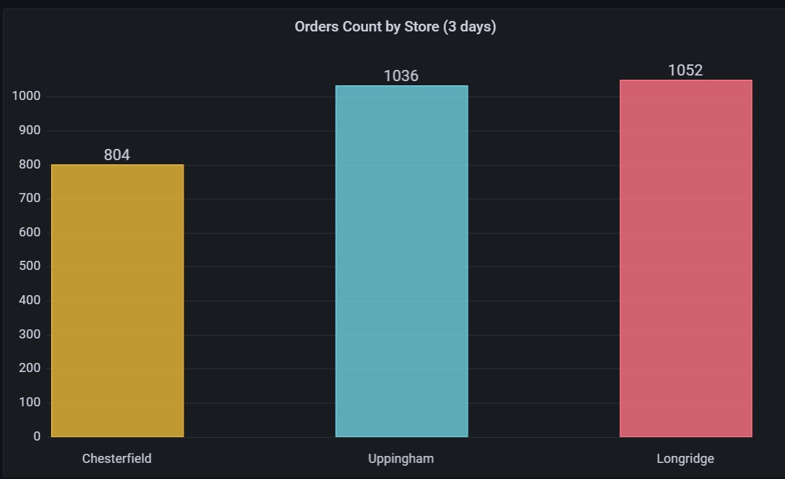
g
Insights from multiple variables
Notes:
Total spent vs timestamp - to analyse peak business hours
Average spent of customer can be calculated
Sales by store based on customer footfall

Slide 15
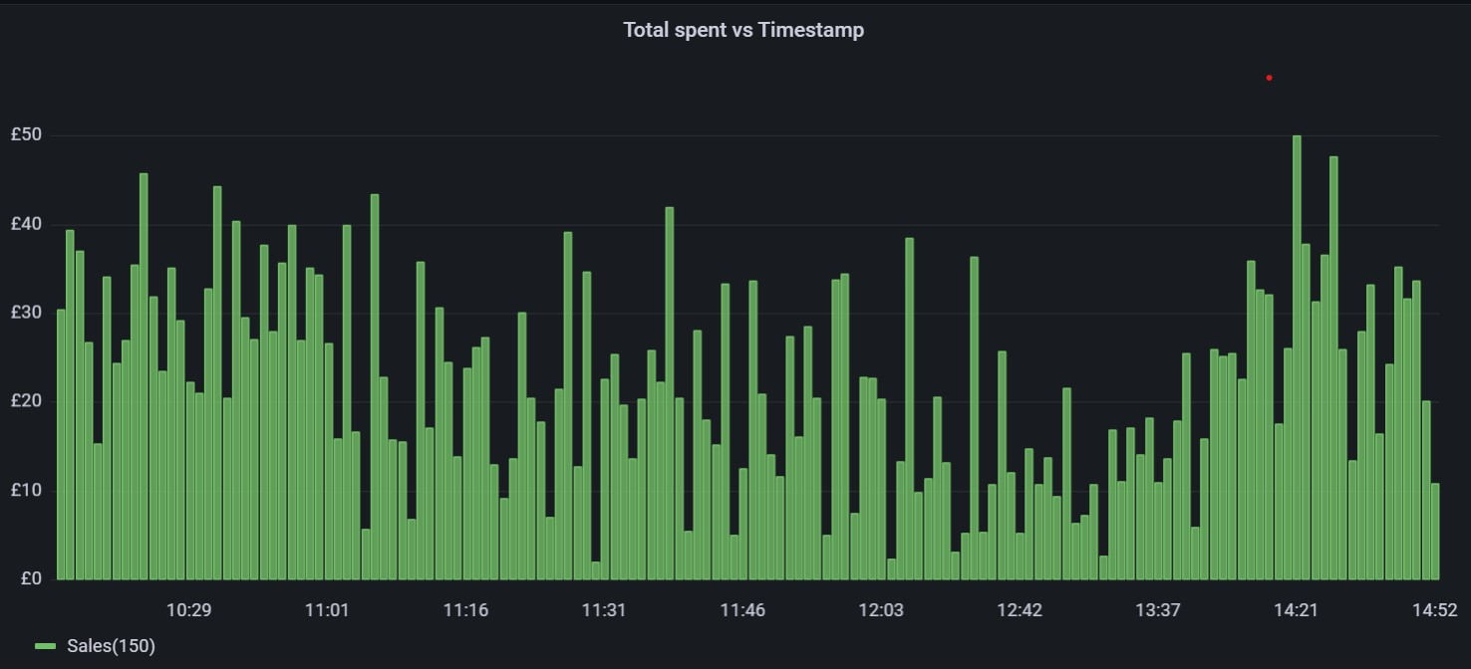
Sales trend over a period of 5 hrs

Slide 16
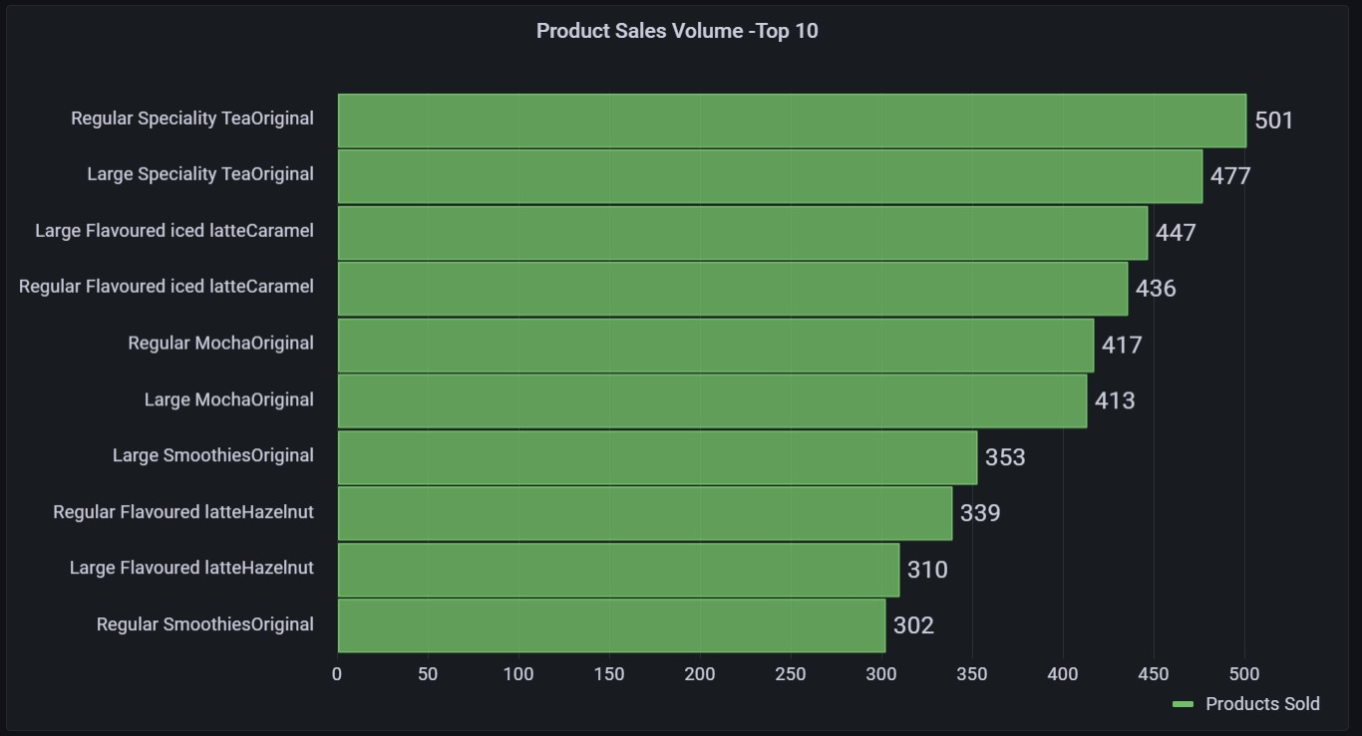
Highest Selling Product by Volume
b
Notes:
Maximum Viable Product
MVP is the product or products that customers would love to order most frequently. If the company focuses on these products, it maximizes profit in the long run.
https://g-5f9fd48be3.grafana-workspace.eu-west-1.amazonaws.com/dashboard/snapshot/SxCZvgoo3gR5yctYJoLLIav5jHylmx6D?orgId=1

Slide 17
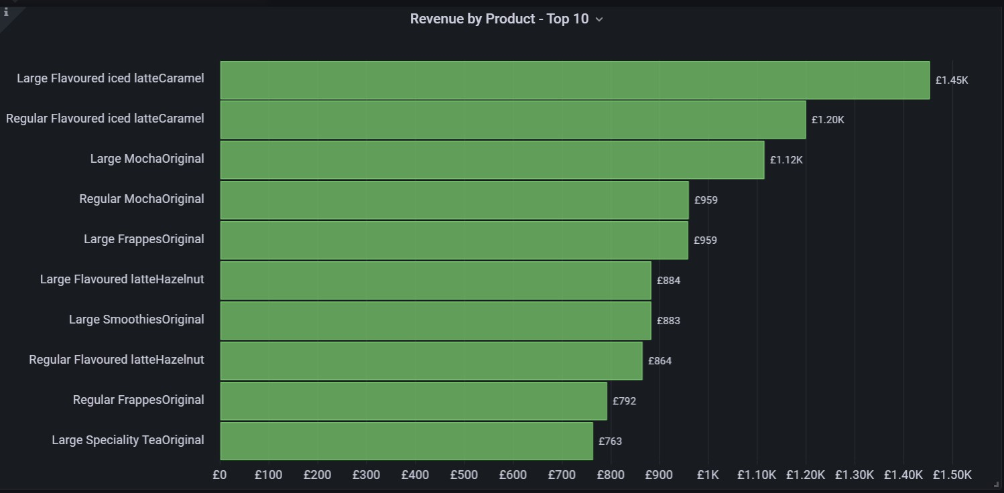
Maximum Viable Product (MVP)
b
Notes:
https://g-5f9fd48be3.grafana-workspace.eu-west-1.amazonaws.com/dashboard/snapshot/ZuzE34jCL446ooKaPJsG4dq42AP4fga5

Slide 18



What? Where? When?
g
What - what items were selling well
Where - best performing store
When - peak business hours

Slide 19

Thanks…for listening
g
Applause to Generation team and Infinity Works from Team 2
Thanks to ……..
Jakub and Rachel
For all your support and motivation
Special thanks to ……..
Bala and Darren
For being there for us & helping us through out
Entire Generation team
Working at backend to make this programme a smooth experience

